Slide 1
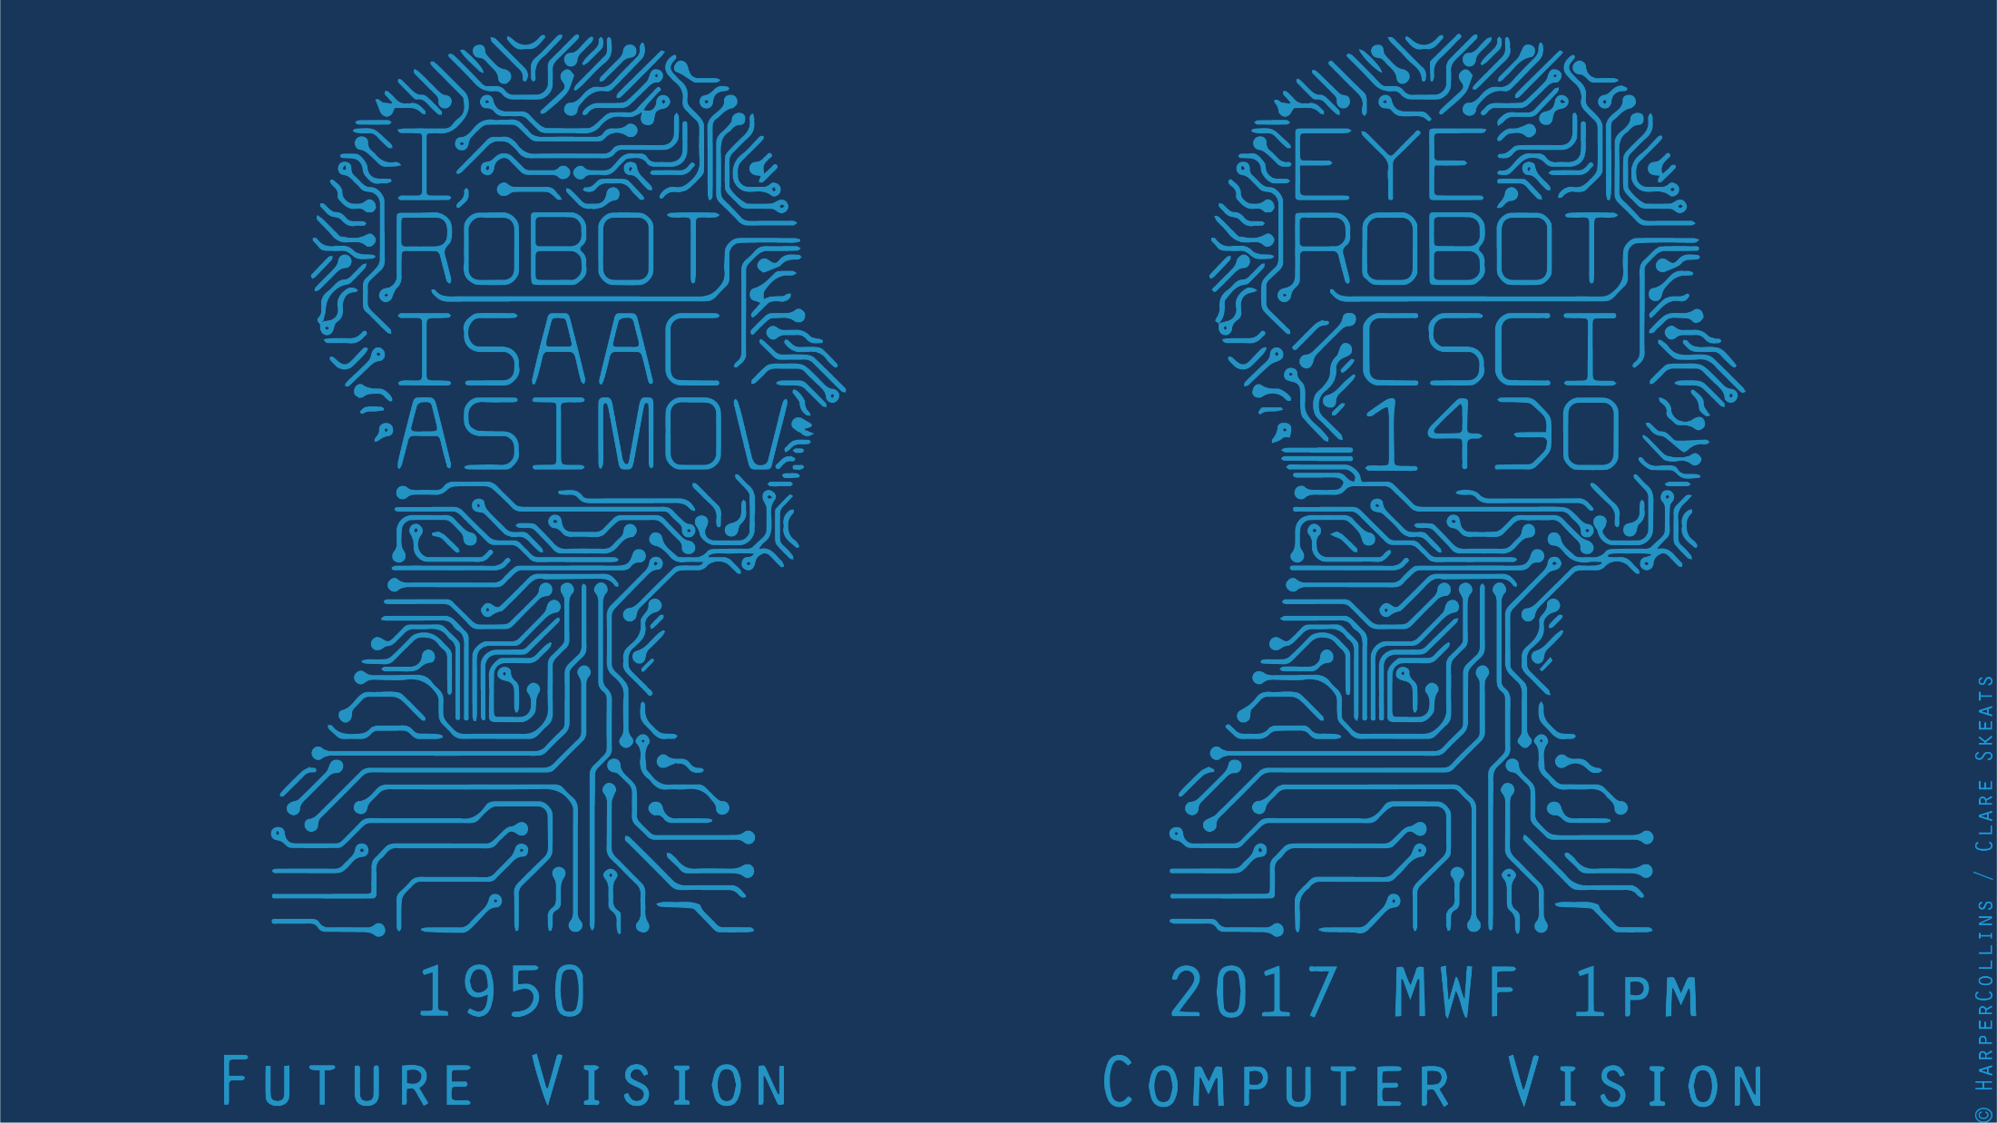

Slide 2
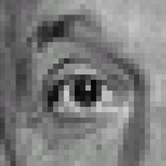

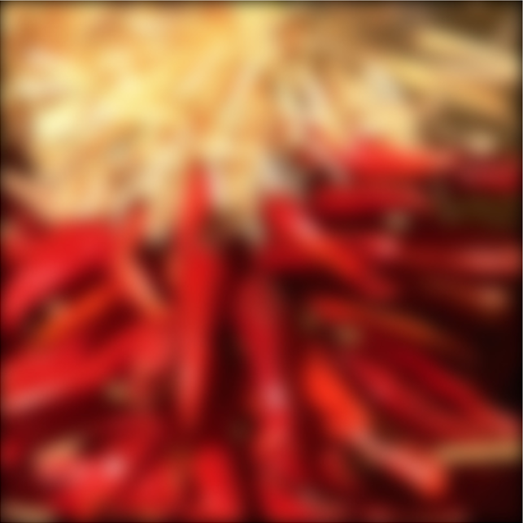
Recap of Monday
Linear filtering (convolution)
Not a matrix multiplication
Sum over Hadamard product
Can smooth, sharpen, translate (among many other uses)
Be aware of details for filter size, extrapolation, cropping
1
1
1
1
1
1
1
1
1
James Hays

Slide 3
Sobel filter visualization
What happens to negative numbers?
For visualization:
Shift image + 0.5
If gradients are small, scale edge response
Notes:
- Look at a second filter which is an ‘edge detection’ filter
Negative numbers
Oh. Well, let’s take the absolute value (the magnitude)
Add the mean

Slide 4

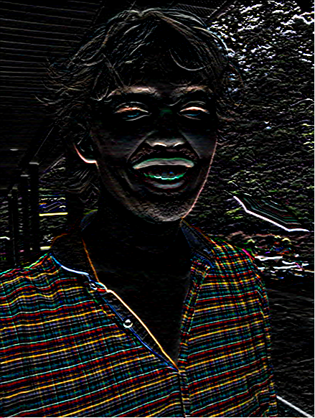
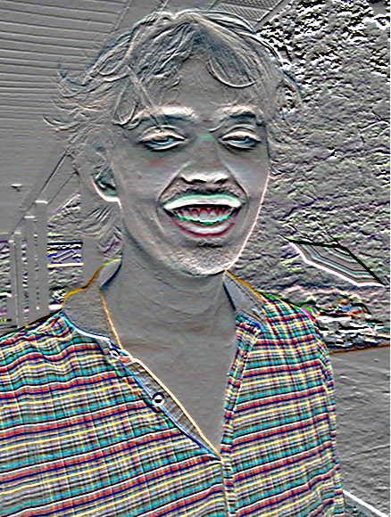
>> I = im2double( imread( ‘luke.jpg’ ) );
>> h = imfilter( I, fspecial(‘sobel’) );
imshow( h );
imshow( h + 0.5 );

Slide 5
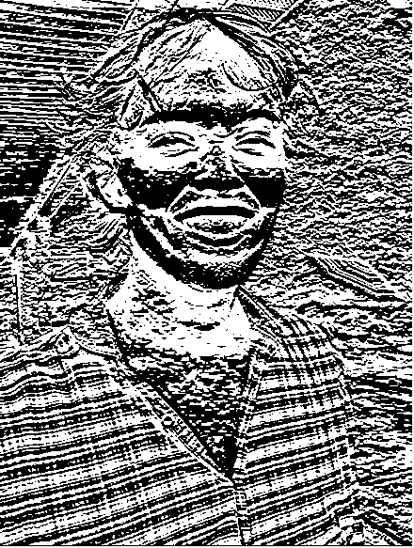
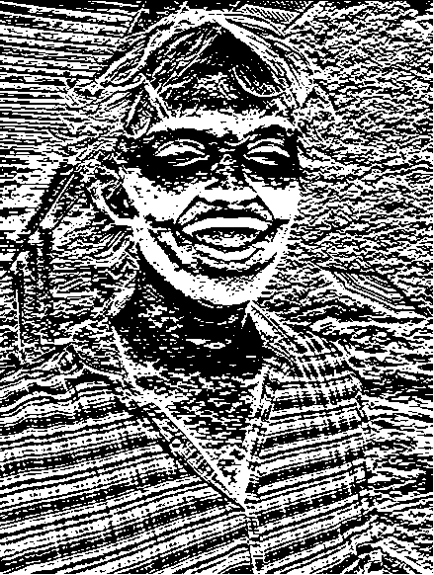
h(:,:,1) < 0
h(:,:,1) > 0

Slide 6
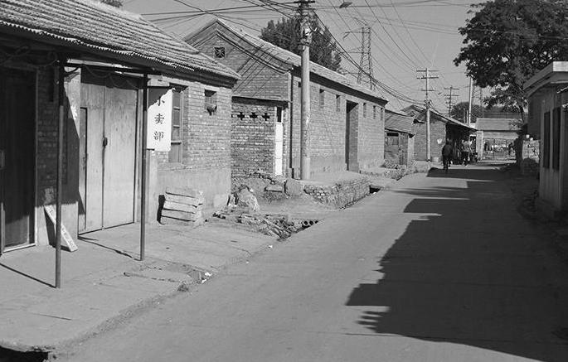

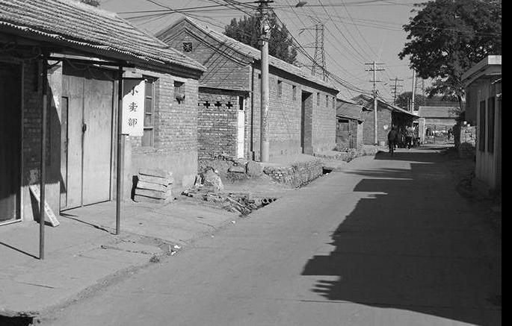
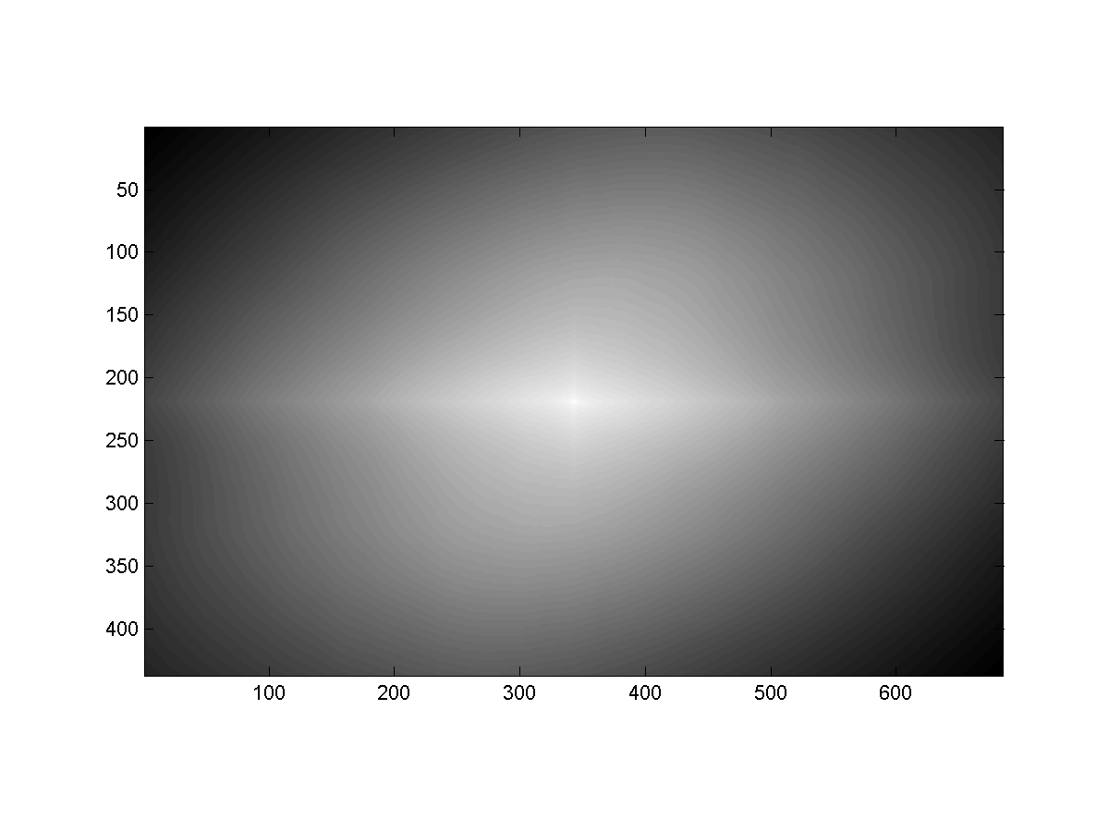
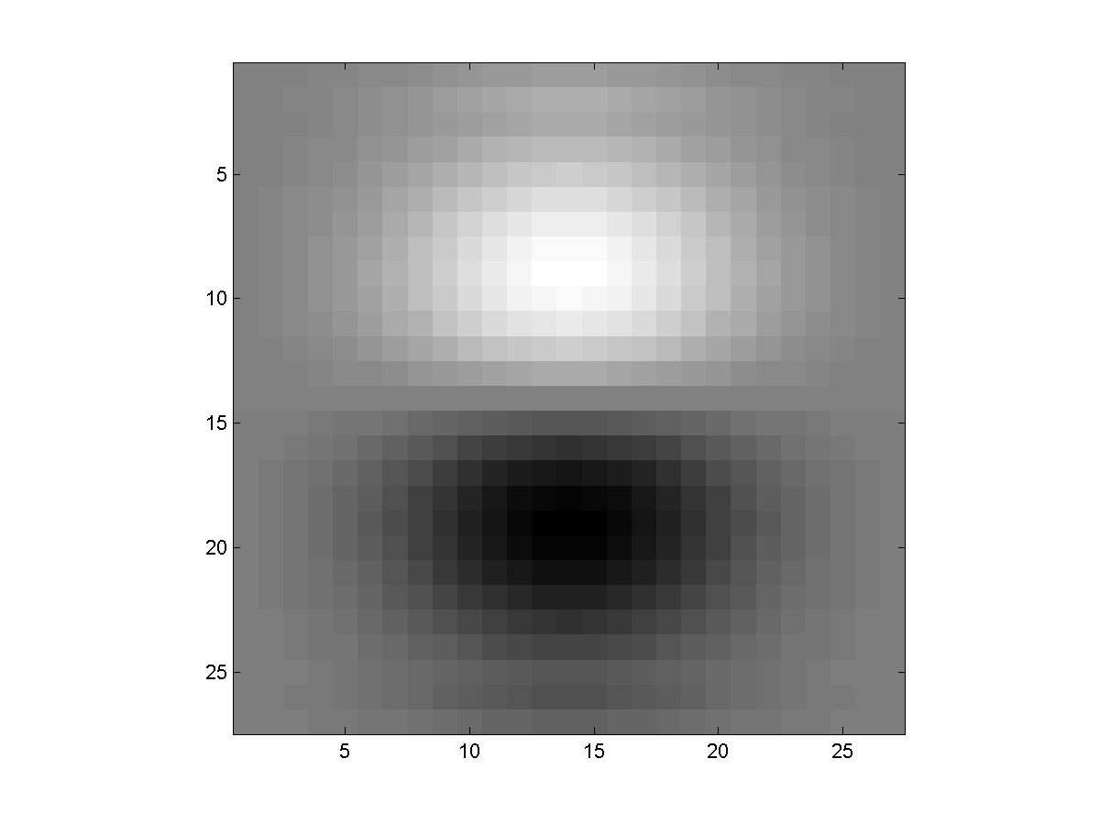
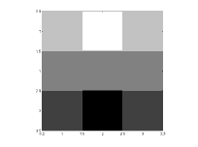
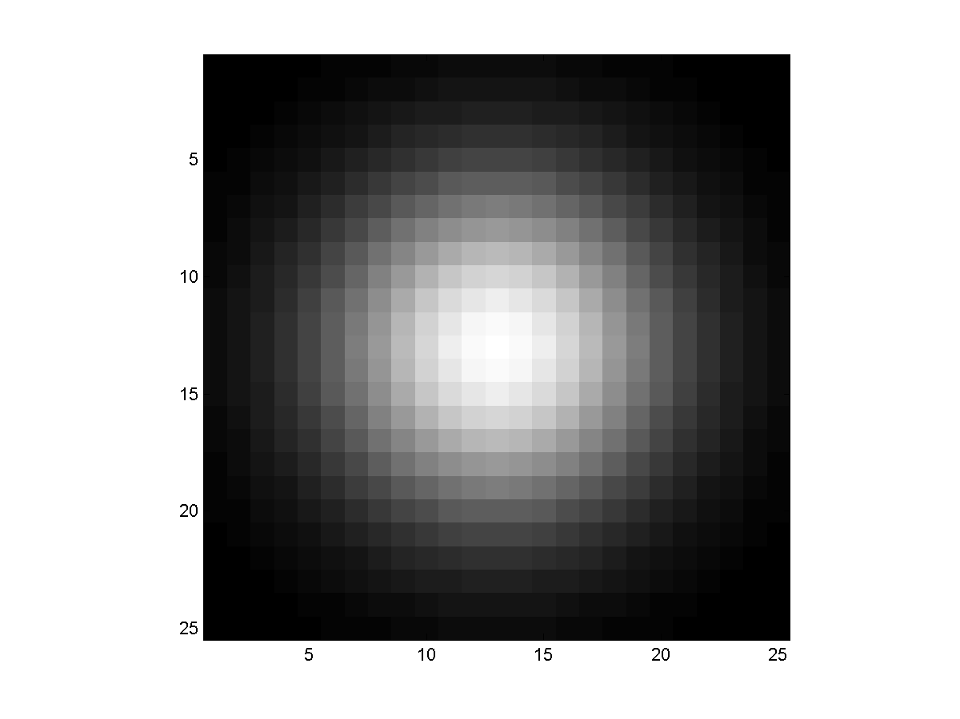
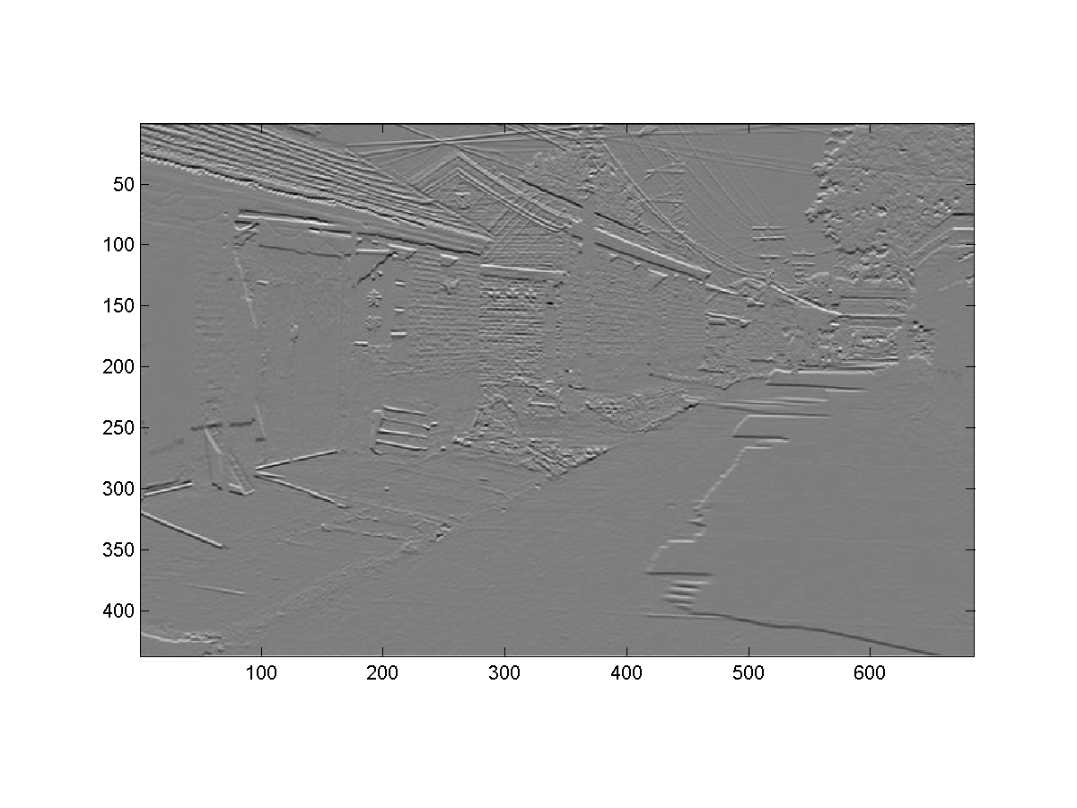
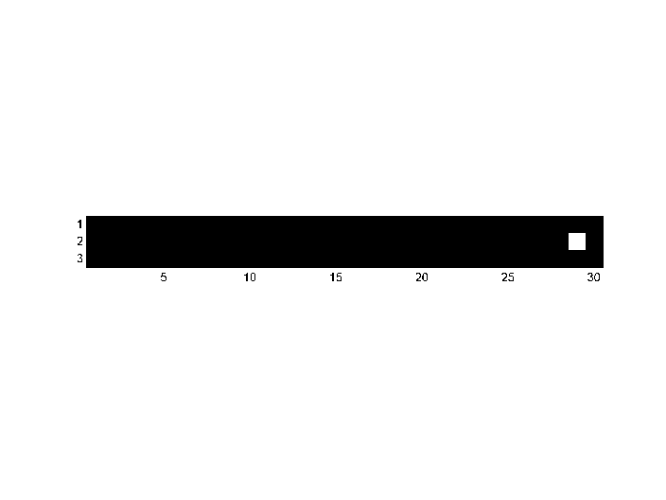
Think-Pair-Share
* = Convolution operator
a) _ = D * B
b) A = _ * _
c) F = D * _
d) _ = D * D
D
H
F
I
A
B
C
G
E
Hoiem
Notes:
a) G = D * B
b) A = B * C
c) F = D * E
d) I = D * D

Slide 7
Non-linear filters

Slide 8
Median filters
Operates over a window by selecting the median intensity in the window.
‘Rank’ filter as based on ordering of gray levels
E.G., min, max, range filters
Steve Seitz, Steve Marschner
Notes:
Better at salt’n’pepper noise
Not convolution: try a region with 1’s and a 2, and then 1’s and a 3

Slide 9
Image filtering - mean
1
1
1
1
1
1
1
1
1
0 | 0 | 0 | 0 | 0 | 0 | 0 | 0 | 0 | 0
0 | 0 | 0 | 0 | 0 | 0 | 0 | 0 | 0 | 0
0 | 0 | 0 | 90 | 90 | 90 | 90 | 90 | 0 | 0
0 | 0 | 0 | 90 | 90 | 90 | 90 | 90 | 0 | 0
0 | 0 | 0 | 90 | 90 | 90 | 90 | 90 | 0 | 0
0 | 0 | 0 | 90 | 0 | 90 | 90 | 90 | 0 | 0
0 | 0 | 0 | 90 | 90 | 90 | 90 | 90 | 0 | 0
0 | 0 | 0 | 0 | 0 | 0 | 0 | 0 | 0 | 0
0 | 0 | 90 | 0 | 0 | 0 | 0 | 0 | 0 | 0
0 | 0 | 0 | 0 | 0 | 0 | 0 | 0 | 0 | 0
 | 0 | 10 | 20 | 30 | 30
?
Credit: S. Seitz
Notes:
ones, divide by 9

Slide 10
Image filtering - mean
1
1
1
1
1
1
1
1
1
0 | 0 | 0 | 0 | 0 | 0 | 0 | 0 | 0 | 0
0 | 0 | 0 | 0 | 0 | 0 | 0 | 0 | 0 | 0
0 | 0 | 0 | 90 | 90 | 90 | 90 | 90 | 0 | 0
0 | 0 | 0 | 90 | 90 | 90 | 90 | 90 | 0 | 0
0 | 0 | 0 | 90 | 90 | 90 | 90 | 90 | 0 | 0
0 | 0 | 0 | 90 | 0 | 90 | 90 | 90 | 0 | 0
0 | 0 | 0 | 90 | 90 | 90 | 90 | 90 | 0 | 0
0 | 0 | 0 | 0 | 0 | 0 | 0 | 0 | 0 | 0
0 | 0 | 90 | 0 | 0 | 0 | 0 | 0 | 0 | 0
0 | 0 | 0 | 0 | 0 | 0 | 0 | 0 | 0 | 0
 | 0 | 10 | 20 | 30 | 30
 |  |  |  | 50
Credit: S. Seitz
Notes:
ones, divide by 9

Slide 11
Median filter?
0 | 0 | 0 | 0 | 0 | 0 | 0 | 0 | 0 | 0
0 | 0 | 0 | 0 | 0 | 0 | 0 | 0 | 0 | 0
0 | 0 | 0 | 90 | 90 | 90 | 90 | 90 | 0 | 0
0 | 0 | 0 | 90 | 90 | 90 | 90 | 90 | 0 | 0
0 | 0 | 0 | 90 | 90 | 90 | 90 | 90 | 0 | 0
0 | 0 | 0 | 90 | 0 | 90 | 90 | 90 | 0 | 0
0 | 0 | 0 | 90 | 90 | 90 | 90 | 90 | 0 | 0
0 | 0 | 0 | 0 | 0 | 0 | 0 | 0 | 0 | 0
0 | 0 | 90 | 0 | 0 | 0 | 0 | 0 | 0 | 0
0 | 0 | 0 | 0 | 0 | 0 | 0 | 0 | 0 | 0
 |  |  |  | ?
Credit: S. Seitz
Notes:
Answer is 90.

Slide 12
Median filters
Operates over a window by selecting the median intensity in the window.
What advantage does a median filter have over a mean filter?
Steve Seitz, Steve Marschner
Notes:
Better at salt’n’pepper noise

Slide 13
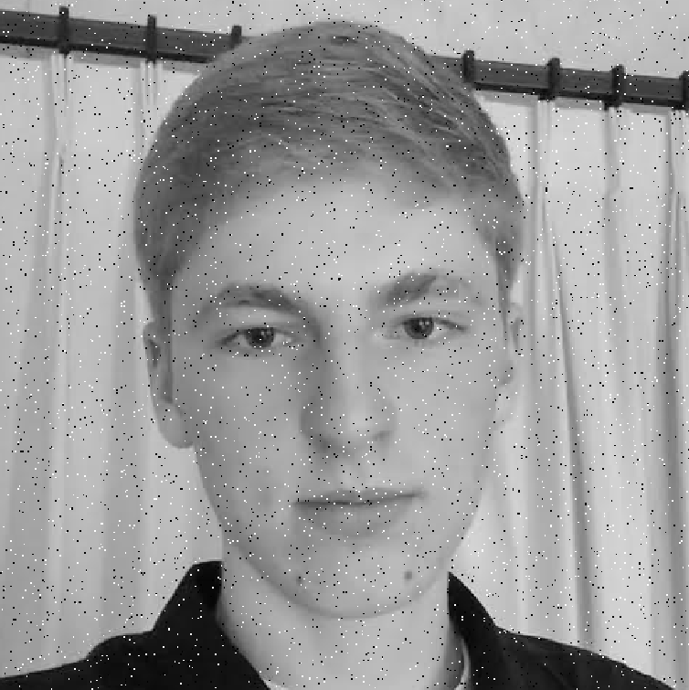
Noisy Jack – Salt and Pepper
Notes:
No, not the latest smash hit from early 90’s hip hop group

Slide 14

Mean Jack – 3 x 3 filter

Slide 15
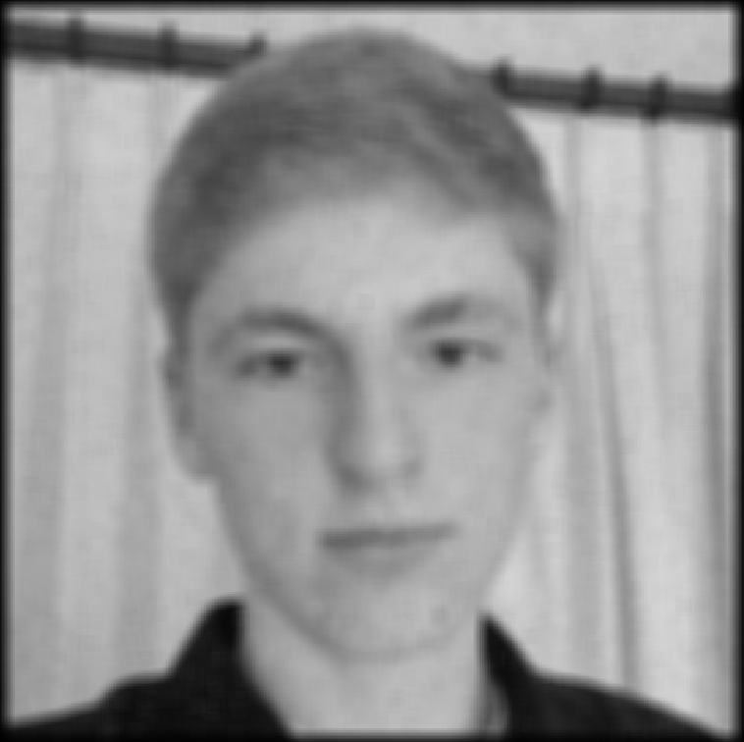
Very Mean Jack – 11 x 11 filter

Slide 16
Noisy Jack – Salt and Pepper
Notes:
No, not the latest smash hit from early 90’s hip hop group

Slide 17
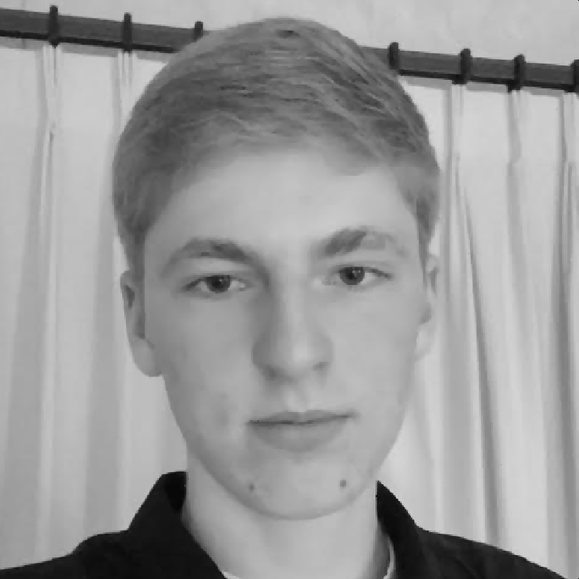
Median Jack – 3 x 3

Slide 18

Very Median Jack – 11 x 11

Slide 19
Median filters
Operates over a window by selecting the median intensity in the window.
What advantage does a median filter have over a mean filter?
Is a median filter a kind of convolution?
Steve Seitz, Steve Marschner
Notes:
Answer: Not convolution: try a region with 1’s and a 2, and then 1’s and a 3

Slide 20
Review: questions
Write down a 3x3 filter that both:
Returns a positive value if the average value of the 4-adjacent neighbors is less than the center,
Returns a negative value otherwise.
Write down a filter that will compute the gradient in the x-direction:
gradx(x,y) = im(x+1,y) - im(x,y) for each x, y
Slide: Hoiem
Notes:
[ 0 -1/4 0;
-1/4 1 -1/4;
0 -1/4 0 ]
[ 0 -1 1 ]

Slide 21
Review: questions
Write down a 3x3 filter that both:
Returns a positive value if the average value of the 4-adjacent neighbors is less than the center,
Returns a negative value otherwise.
Write down a filter that will compute the gradient in the x-direction:
gradx(x,y) = im(x+1,y) - im(x,y) for each x, y
[ 0 -1/4 0;
-1/4 1 -1/4;
0 -1/4 0 ]
[ 0 -1 1 ]
Slide: Hoiem
Notes:
[ 0 -1/4 0;
-1/4 1 -1/4;
0 -1/4 0 ]
[ 0 -1 1 ]

Slide 22
Median filters
Operates over a window by selecting the median intensity in the window.
What advantage does a median filter have over a mean filter?
Is a median filter a kind of convolution?
Secret: Median filtering is sorting.
Notes:
Answer: Not convolution: try a region with 1’s and a 2, and then 1’s and a 3

Slide 23
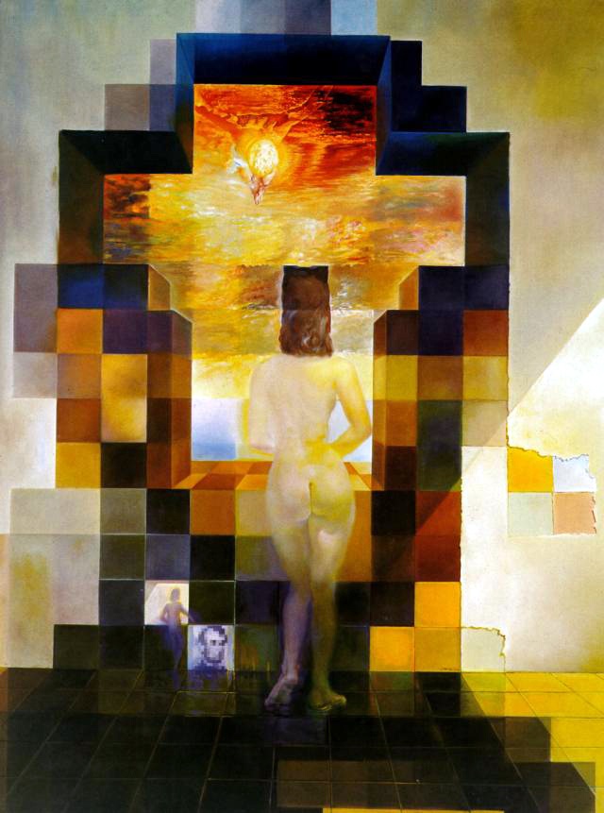
Salvador Dali, 1976

Slide 24
Today’s Class
Spatial frequency
Fourier transform and frequency domain
Frequency view of filtering
Hybrid images
Sampling
Reminder: Textbook
Today’s lecture covers material in 3.4
Slide: Hoiem

Slide 25


Why does a lower resolution image still make sense to us? What information do we lose?
Image: http://www.flickr.com/photos/igorms/136916757/
Slide: Hoiem

Slide 26
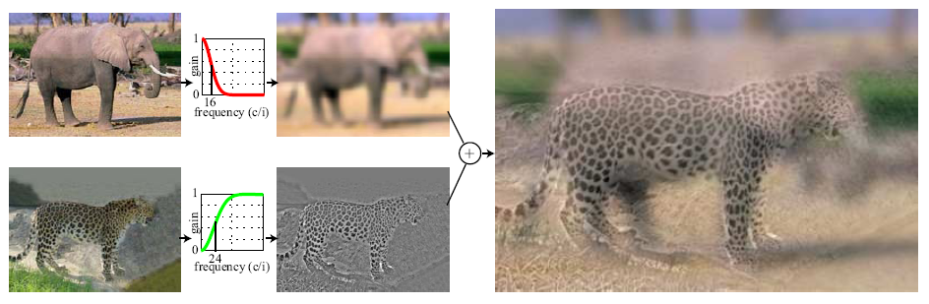
Hybrid Images
Hays
A. Oliva, A. Torralba, P.G. Schyns, “Hybrid Images,” SIGGRAPH 2006

Slide 27
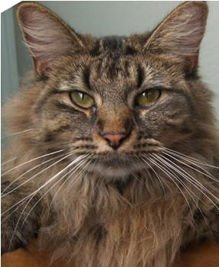
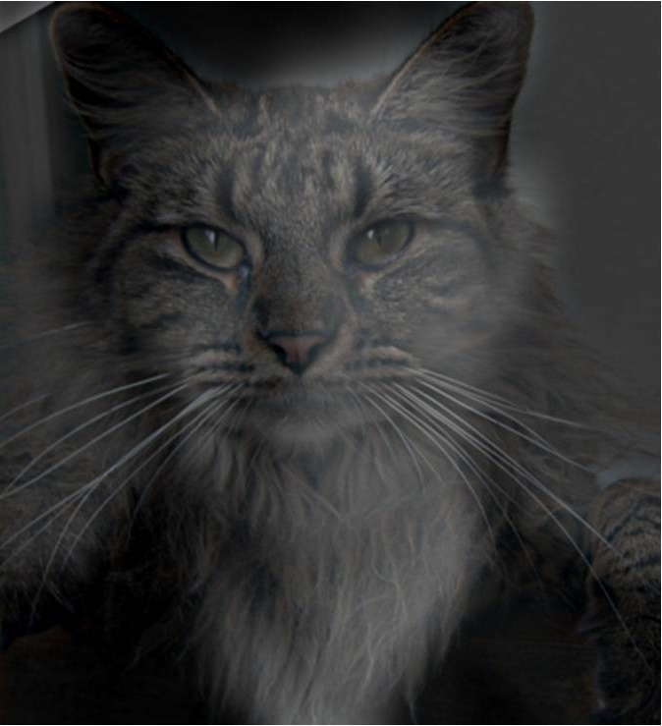
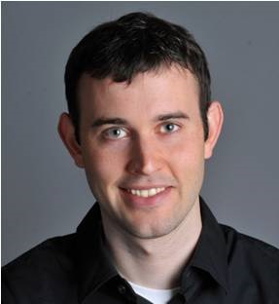
Why do we get different, distance-dependent interpretations of hybrid images?
?
Slide: Hoiem

Slide 28
How is it that a 4MP image can be compressed to a few hundred KB without a noticeable change?

Slide 29
Sampling
Why does a lower resolution image still make sense to us? What do we lose?
Image: http://www.flickr.com/photos/igorms/136916757/

Slide 30
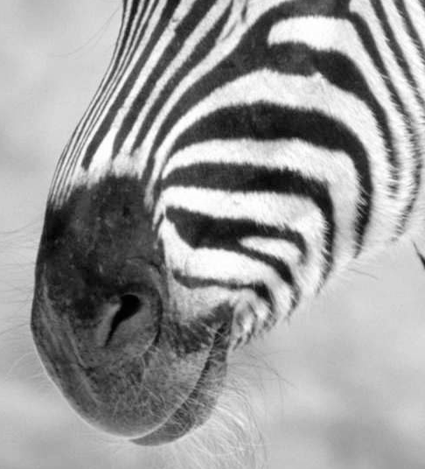
Subsampling by a factor of 2
Throw away every other row and column to create a 1/2 size image

Slide 31
Sampling and aliasing

Slide 32
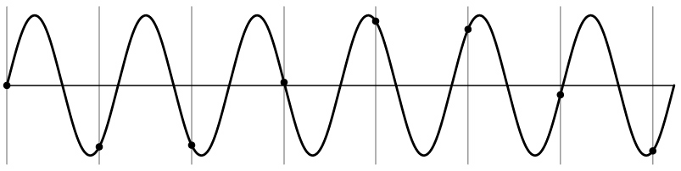
Aliasing problem
1D example (sinewave):
Source: S. Marschner

Slide 33
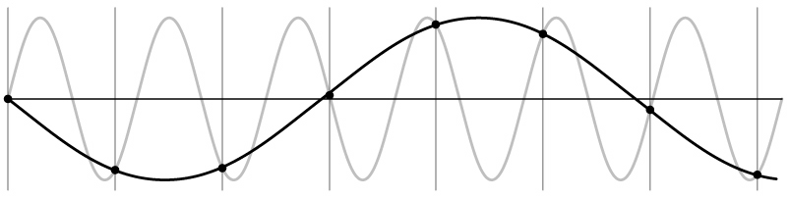
Aliasing problem
1D example (sinewave):
Source: S. Marschner

Slide 34
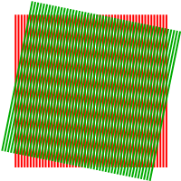
Aliasing problem
Sub-sampling may be dangerous….
Characteristic errors may appear:
“car wheels rolling the wrong way in movies”
“checkerboards disintegrate in ray tracing”
“striped shirts look funny on color television”
Moiré patterns
Source: D. Forsyth; Wikipedia

Slide 35
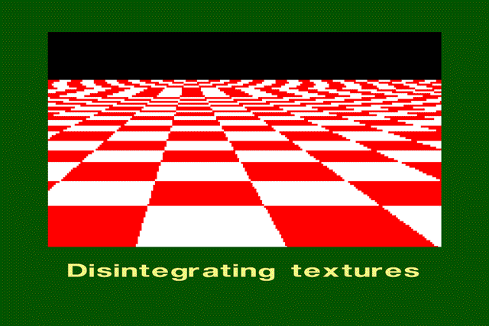
Aliasing in graphics
Source: A. Efros

Slide 36
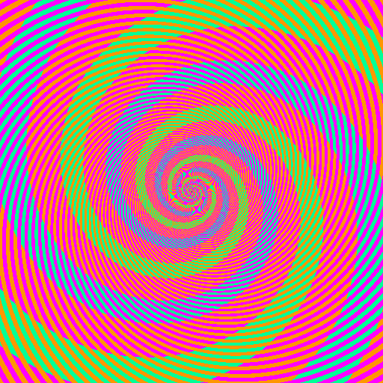

Slide 37
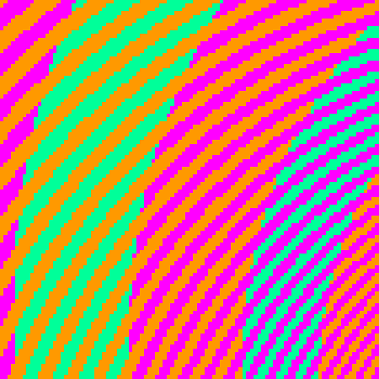
The blue and green colors are actually the same
http://blogs.discovermagazine.com/badastronomy/2009/06/24/the-blue-and-the-green/

Slide 38
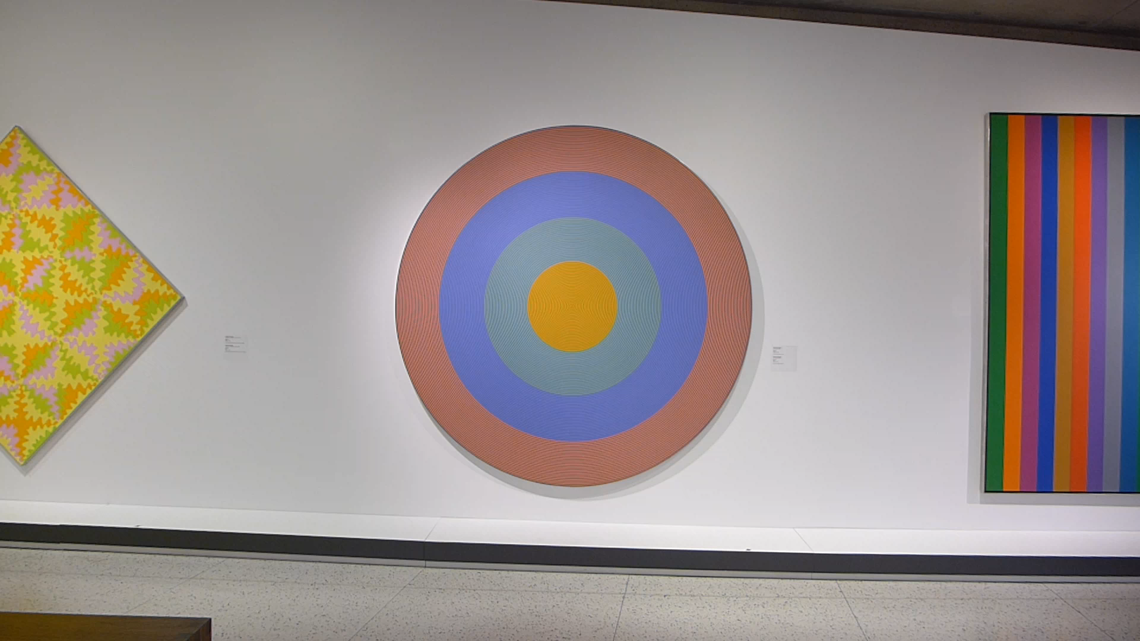
Aliasing and Moiré patterns
Gong 96, 1932, Claude Tousignant, Musée des Beaux-Arts de Montréal

Slide 39
Videos
Notes:
https://www.youtube.com/watch?v=Y1yHMy0-4TM
https://www.youtube.com/watch?v=jQDjJRYmeWg

Slide 40
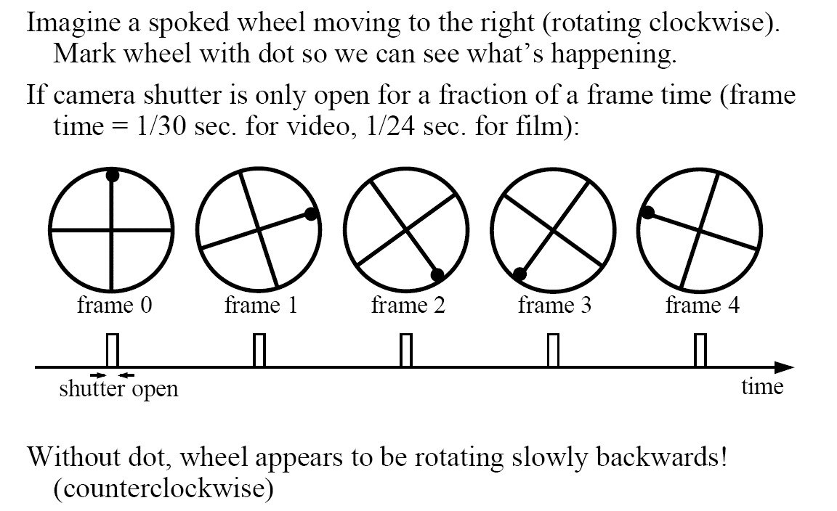
Aliasing in video
Slide by Steve Seitz

Slide 41
Nyquist-Shannon Sampling Theorem
When sampling a signal at discrete intervals, the sampling frequency must be ≥ 2 × f_{max}
f_{max} = max frequency of the input signal
This will allows to reconstruct the original perfectly from the sampled version
v
v
v
good
bad

Slide 42
How to fix aliasing?
Solutions?

Slide 43
Better sensors
Solutions:
Sample more often

Slide 44
Anti-aliasing
Solutions:
Sample more often
Get rid of all frequencies that are greater than half the new sampling frequency
Will lose information
But it’s better than aliasing
Apply a smoothing (low pass) filter
Hays

Slide 45
Anti-aliasing
Forsyth and Ponce 2002

Slide 46
Algorithm for downsampling by factor of 2
Start with image(h, w)
Apply low-pass filter
im_blur = imfilter( image, fspecial(‘gaussian’, 7, 1) )
Sample every other pixel
im_small = im_blur( 1:2:end, 1:2:end );
Hays

Slide 47
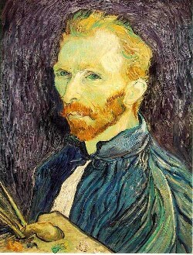
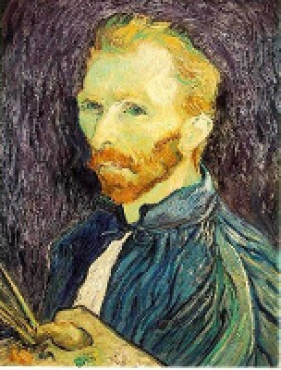
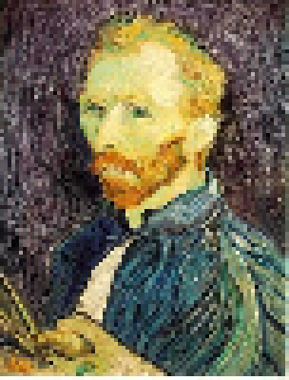
Subsampling without pre-filtering
1/2
1/4 (2x zoom)
1/8 (4x zoom)
Steve Seitz

Slide 48



Subsampling with Gaussian pre-filtering
Gaussian 1/2
G 1/4
G 1/8
Steve Seitz

Slide 49
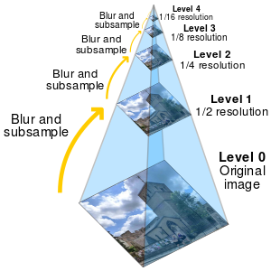
Image Pyramids
Project 1 function:
vis_hybrid_image.m
Wikipedia – Image Pyramids

Slide 50
Why do we get different, distance-dependent interpretations of hybrid images?
?
Hays

Slide 51
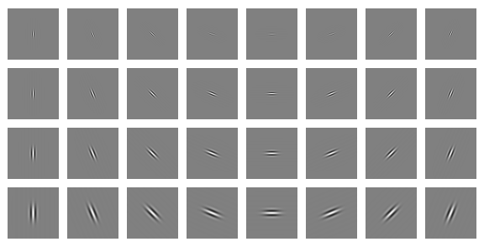
Clues from Human Perception
Early processing in humans filters for orientations and scales of frequency.
Early Visual Processing: Multi-scale edge and blob filters

Slide 52
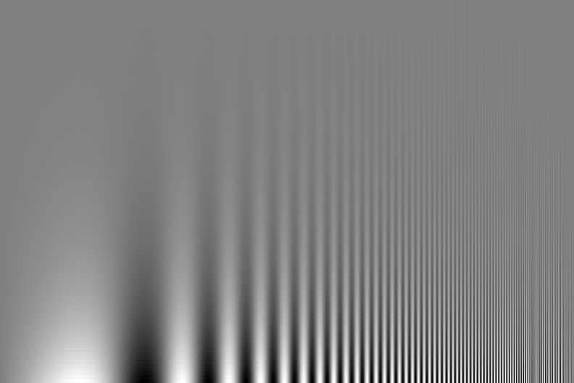
Campbell-Robson contrast sensitivity curve
Perceptual cues in the mid-high frequencies dominate perception.
Contrast decrease (log)
Frequency increase (log)
Notes:
Ask students to look at the image and think about where the line of constant response is -

Slide 53
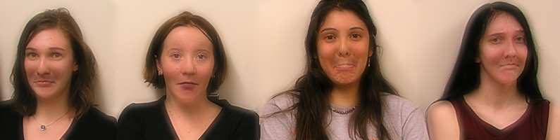

Application: Hybrid Images
When we see an image from far away, we are effectively subsampling it!
A. Oliva, A. Torralba, P.G. Schyns, SIGGRAPH 2006

Slide 54
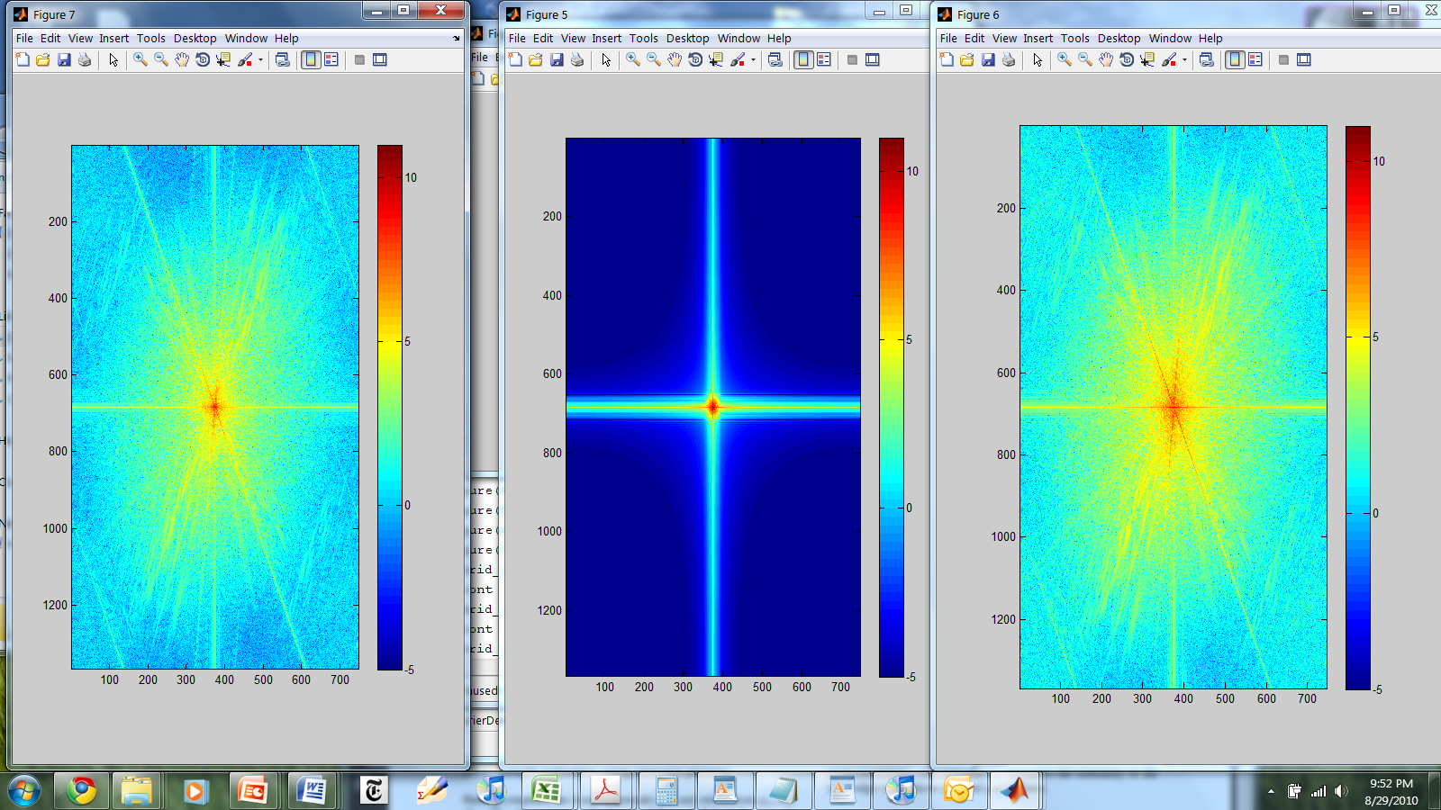
Hybrid Image in FFT
Hybrid Image
Low-passed Image
High-passed Image

Slide 55
Hays
Salvador Dali
“Gala Contemplating the Mediterranean Sea,
which at 30 meters becomes the portrait
of Abraham Lincoln”, 1976
Notes:
Gala was Dali’s wife.

Slide 56
Salvador Dali invented Hybrid Images?
Salvador Dali
“Gala Contemplating the Mediterranean Sea,
which at 30 meters becomes the portrait
of Abraham Lincoln”, 1976
Notes:
Gala was Dali’s wife.

Slide 57
